Slide 1

GROUP PRESENTATION · AN INTERESTING PLACE
西安
XI'AN
西安 · once called Chang'an 长安, "lasting peace"
Where ancient China still breathes.
3,100 years old · capital of 13 dynasties · home of the Terracotta Army
长安
01 INTRODUCTION · 02 FACTS · 03 OPINION (POSITIVES) · 04 OPINION (NEGATIVES) · 05 SUMMARY

Slide 2

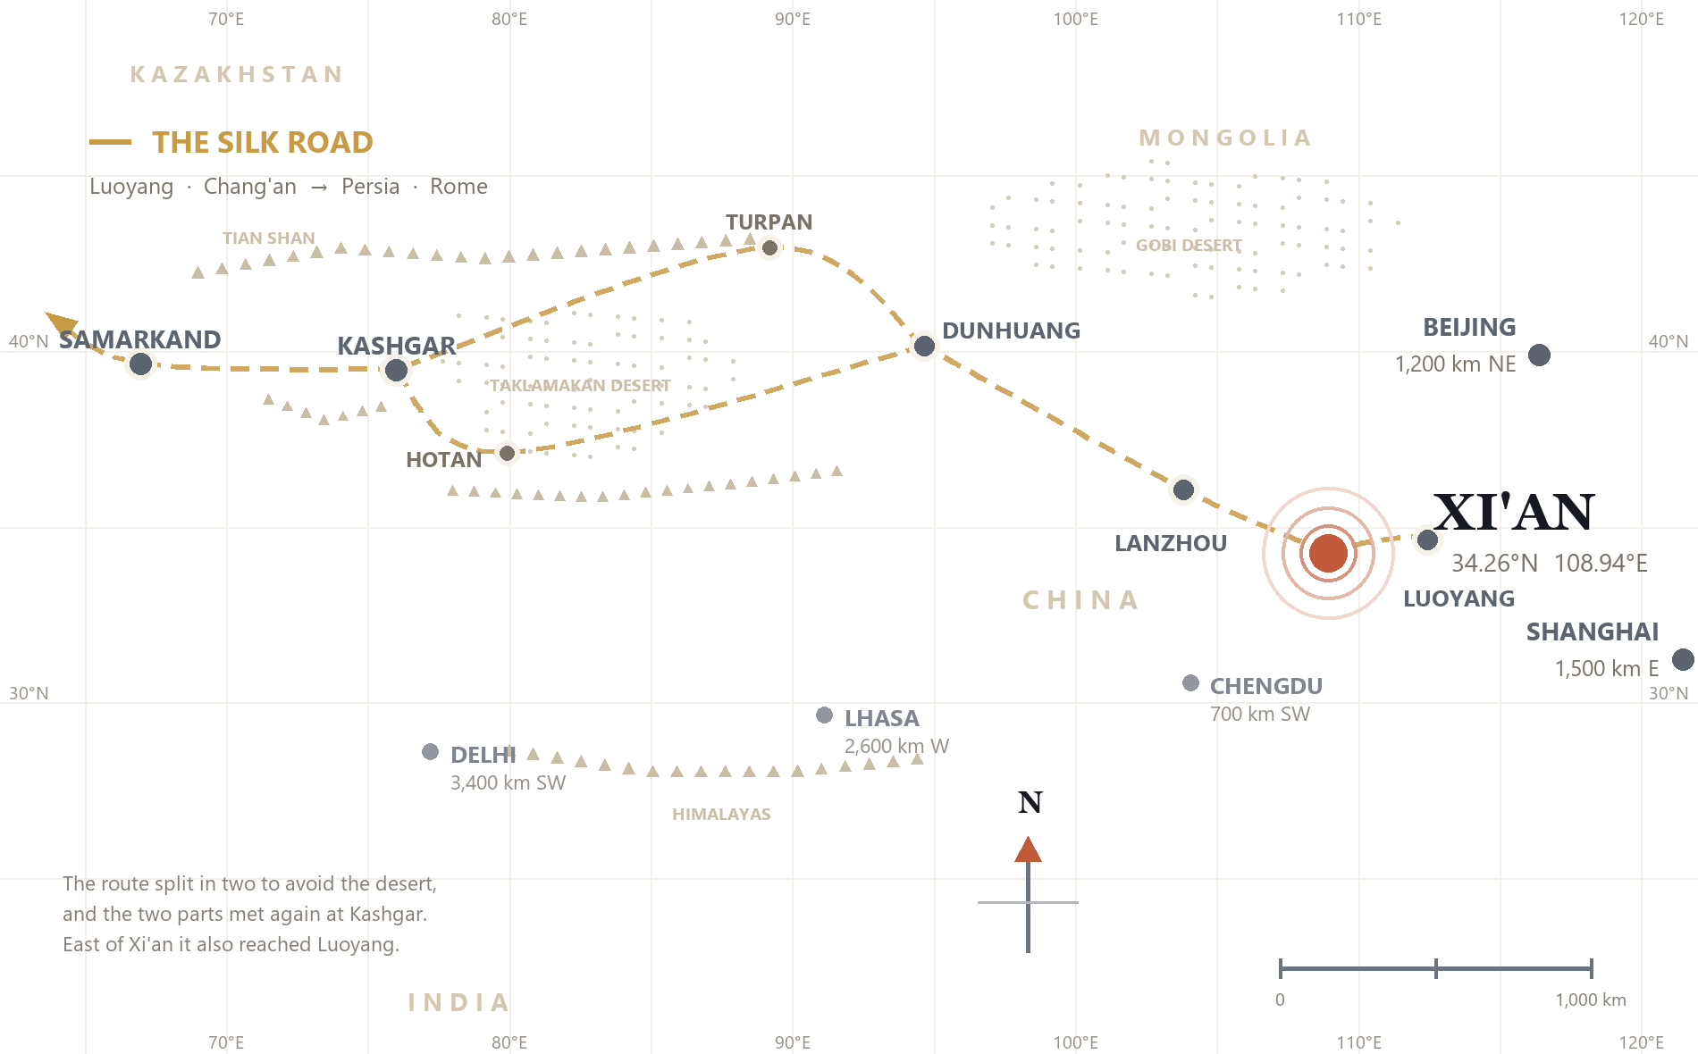
01 · INTRODUCTION AND GENERAL FACTS
Where in the world is Xi'an?
An ancient city in the northwest of China, and the best-known starting point of the Silk Road.
NAME
Xi'an 西安 — "western peace"
For a thousand years it was called Chang'an 长安, "lasting peace". The name changed in the Ming dynasty.
COUNTRY
China · Shaanxi Province · Northwest China
Also called the "Thirteen-Dynasty Ancient Capital" — with Athens, Rome and Cairo, one of the world's four great ancient capitals.
LOCATION
34.3°N, 108.9°E · the Guanzhong Plain
Far from the sea, in a river valley surrounded by mountains — the door between the plains and the west.
Xi'an sits in the centre of China's northwest — where the plains meet the deserts of the west.
13.2 million people · 4 h 10 from Beijing by train · 63 universities
XI'AN · AN INTERESTING PLACE
02

Slide 3

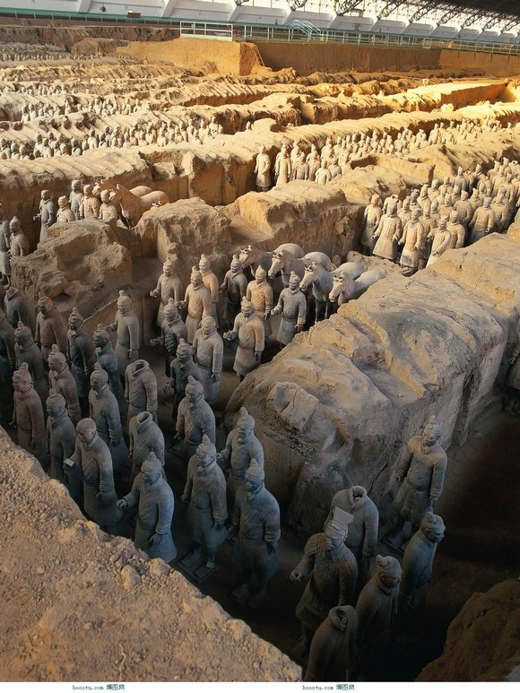
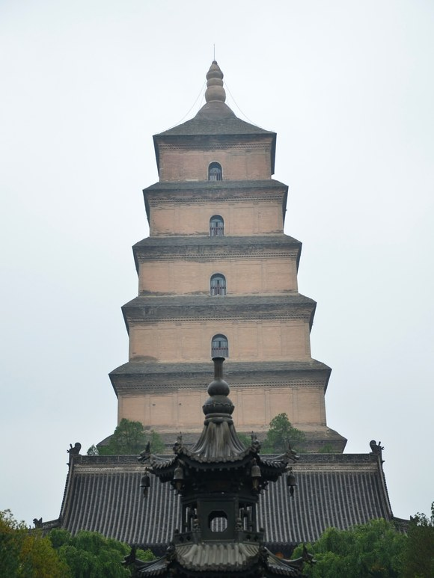
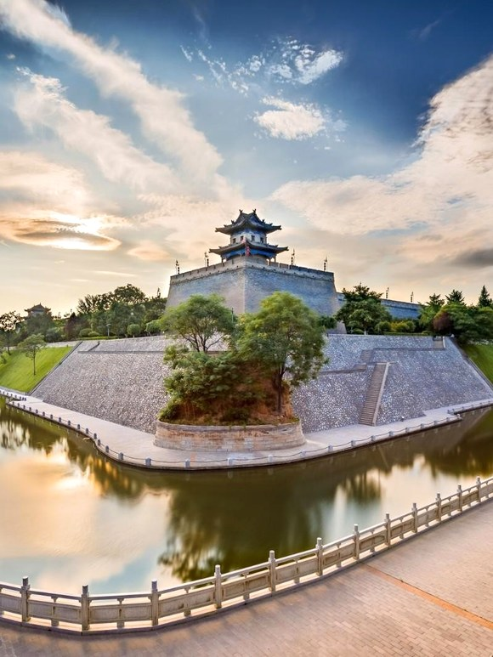
02 · FACTS
How old — and who made it
Over 3,000 years old and an ancient capital of 13 dynasties — but not made by one person.
WHO MADE IT?
Xi'an grew over time — four dynasties built it.
Zhou
Western Han
Sui
Tang
ABOUT 3,000 YEARS AGO
202 BC
AD 582
AD 618–907
King Wen built Feng Jing and King Wu built Gao Jing. This is where the history of Xi'an begins.
Liu Bang made the city his capital and named it Chang'an — long-term peace and order.
Emperor Wen, Yang Jian, built Daxing City to the southeast of the old city.
Chang'an became the largest city in the world, and guests came from everywhere.
WHAT IT LEFT THE WORLD
The Terracotta Army
Big Wild Goose Pagoda
The city wall today
The Qin swept across the Six States here. The army is what it left behind.
The Silk Road started here, by Zhang Qian. In Tang times visitors came from all over the world.
The ancient walls and the old Bell Tower still draw visitors. The subway now runs through Han and Tang layers.
AD 755 · THE AN SHI REBELLION The Tang turned to decline, and in 904 the city was destroyed.
1936 · THE XI'AN INCIDENT The turning point that stopped the civil war and united the country against Japan.
XI'AN · AN INTERESTING PLACE
03

Slide 4
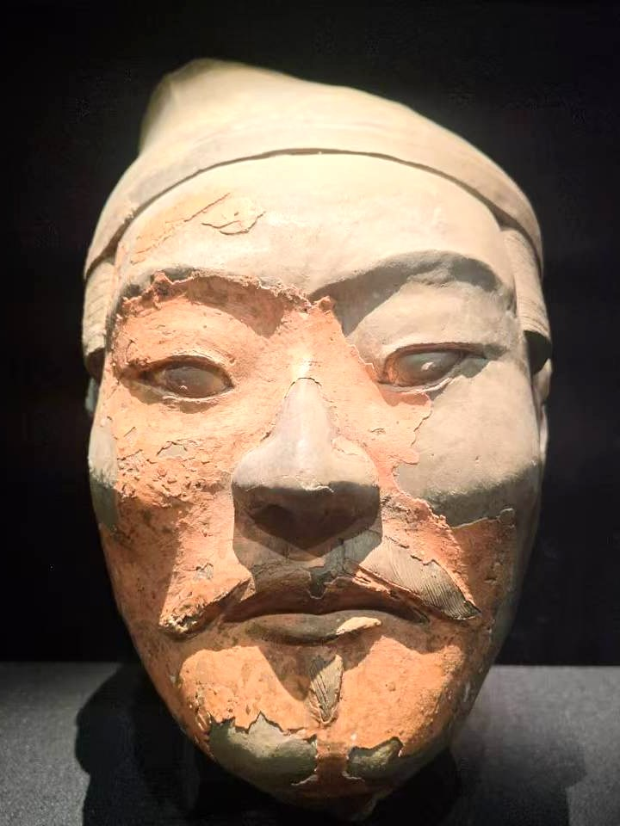
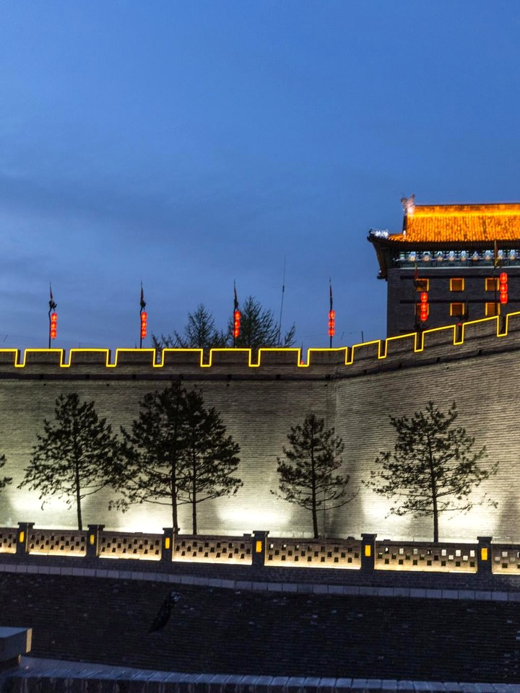
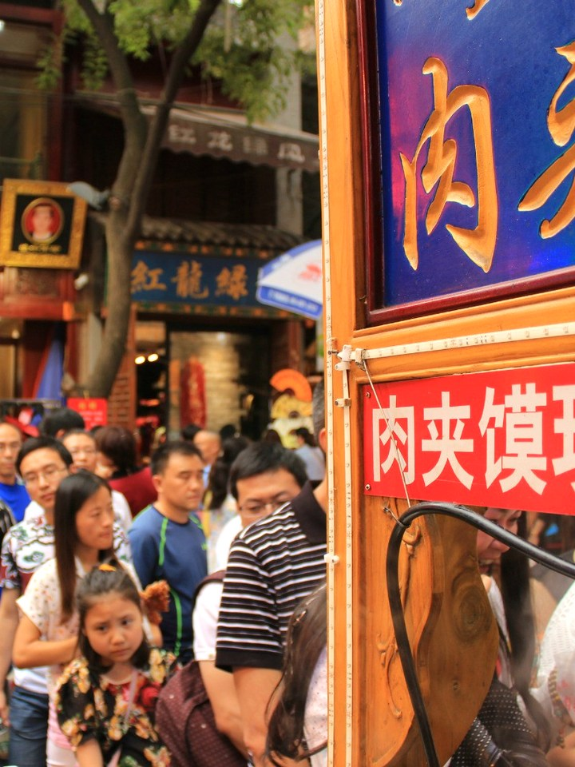
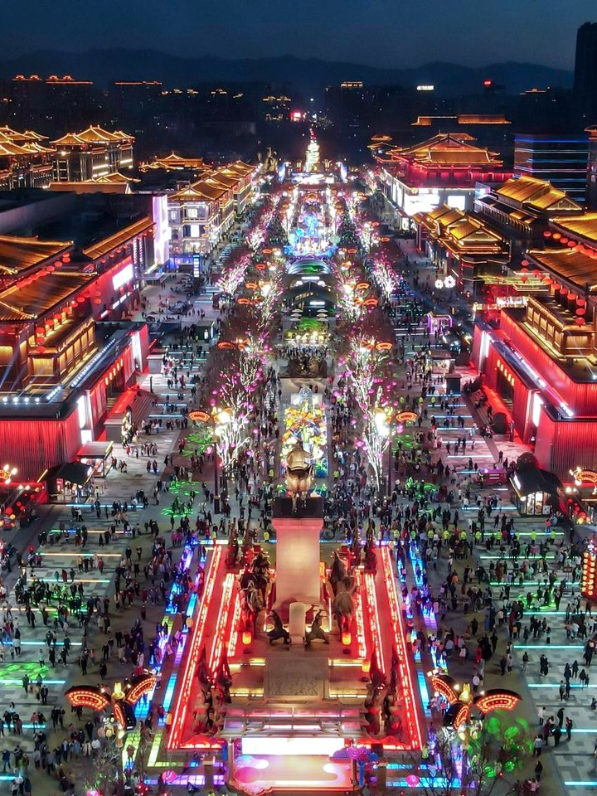
03 · OPINION (POSITIVES)
What we loved
Four things we would go back for — and one line on why each one is worth it.
MUST-SEE
BEST TWO HOURS
The Terracotta Army
Cycling the city wall
8,000 life-size soldiers, no two faces the same, buried for 2,200 years.
You ride on top of 13.74 km of Ming bricks, 12 m above the town.
40 km east · half a day · book ahead
Rent at the South Gate · ¥45
BEST FOOD
BEST AT NIGHT
The Muslim Quarter
Datang Everbright City
A living Hui area full of lamb on sticks, flat bread and hot pepper.
A Tang street that comes alive with lights, beside the Big Wild Goose Pagoda.
Behind the Drum Tower · go at night
Free to walk · go after dark
ALSO WORTH IT Shaanxi History Museum · Bell and Drum Tower · Mount Hua day trip · Huaqing Palace
XI'AN · AN INTERESTING PLACE
04

Slide 5

04 · OPINION (NEGATIVES)
The honest part
Nothing is perfect. These are the things visitors really complain about.
Booking is the hard part
You must book with your real name and choose a time. Only 65,000 people can go in each day, and at Spring Festival it sells out. You also need your passport number.
Crowds — and a long way out
On the busiest days all the tickets go, and the site is 40 km east of town. The subway and bus take about two hours each way, so the trip takes half a day.
Tickets are not cheap
¥120 for the army, ¥54 for the wall, ¥45 for a bike: ¥174 before you have eaten anything.
Summer is hard
In July the temperature is about 35 °C in the day, and 33 °C in August. Fog can make the view from the wall less clear.
Tourist food is not always good
The Muslim Quarter is the famous food street, but the prices are high and it is always full of visitors. Local people eat one street further in.
Watch out near the site
Local news has reported guides and drivers taking visitors to fake "underground palace" shows — one family paid ¥564 for ten minutes.
XI'AN · AN INTERESTING PLACE
05

Slide 6

05 · SUMMARY
Go — but go smart.
Xi'an is not a relaxing city, and it is not a hidden one. But nowhere else gives you three thousand years in a single weekend: an emperor's army, a wall you can cycle, and the food that other Chinese cities try to match.
The good parts win easily. Just do not go in July, and do not arrive without a booking.
IF YOU GO
BEST TIME
April to May, or September to October.
HOW LONG
Three to four days; the army takes a full day.
WHERE TO STAY
Inside the city wall, near the Bell Tower.
BOOK AHEAD
Book the army and the museum online.
One-line answer: yes — go in the right season, and book before you fly.
XI'AN · AN INTERESTING PLACE
06

Slide 7

长安
Thank you
Questions?
Xi'an · 西安 · Shaanxi, China
01 INTRODUCTION · 02 FACTS · 03 OPINION (POSITIVES) · 04 OPINION (NEGATIVES) · 05 SUMMARY

